Slide 1
Statistical Literacy: An Overview
Milo Schield, Univ. New Mexico
Fellow: American Statistical Association
Member: International Statistical Institute
US Rep: International Statistical Literacy Project Visiting Professor: New College of Florida
ISLP Invited Session
August 2, 2023
www.StatLit.org/pdf/2023-Schield-ASA-Slides.pdf
www.StatLit.org/pdf/2023-Schield-ASA.pdf
Notes:
StatLit for Managers
2013
2013Schield-MBAA
1
Analyzing Numbers in the News
15 May 2008
2008SchieldNNN6up.pdf
1
1
Three parts: Overview: Standardizing, UNM/Cornfield

Slide 2
Statistical Literacy is GAISE 2016 Compliant
Statistical Literacy (UNM Math 1300):
is multivariate (MV). Students work problems to control for confounder influence on associations or statistical significance without using computers.
focuses on everyday statistics: statistics used in arguments that citizens encounter everyday.
involves writing: 30% of students’ grade
Uses real data. Textbook: 175 tables & 50 graphs
Notes:
StatLit for Managers
2013
2013Schield-MBAA
2
Analyzing Numbers in the News
15 May 2008
2008SchieldNNN6up.pdf
2
2

Slide 3
Students’ View of Statistical Literacy
Students think confounder-based multivariate statistical literacy (UNM Math 1300) is important:
More than a fourth taking Math1300 in 2022-23 agreed that statistical literacy should be required of all students for gradation.
Half said statistical literacy did more to help their critical thinking than any course they had taken
Notes:
StatLit for Managers
2013
2013Schield-MBAA
3
Analyzing Numbers in the News
15 May 2008
2008SchieldNNN6up.pdf
3
3

Slide 4
Arguments: From “Seen” to “Unseen”
1
.
Association describes what is seen (observed).
Notes:
StatLit for Managers
2013
2013Schield-MBAA
4
Analyzing Numbers in the News
15 May 2008
2008SchieldNNN6up.pdf
4
4

Slide 5
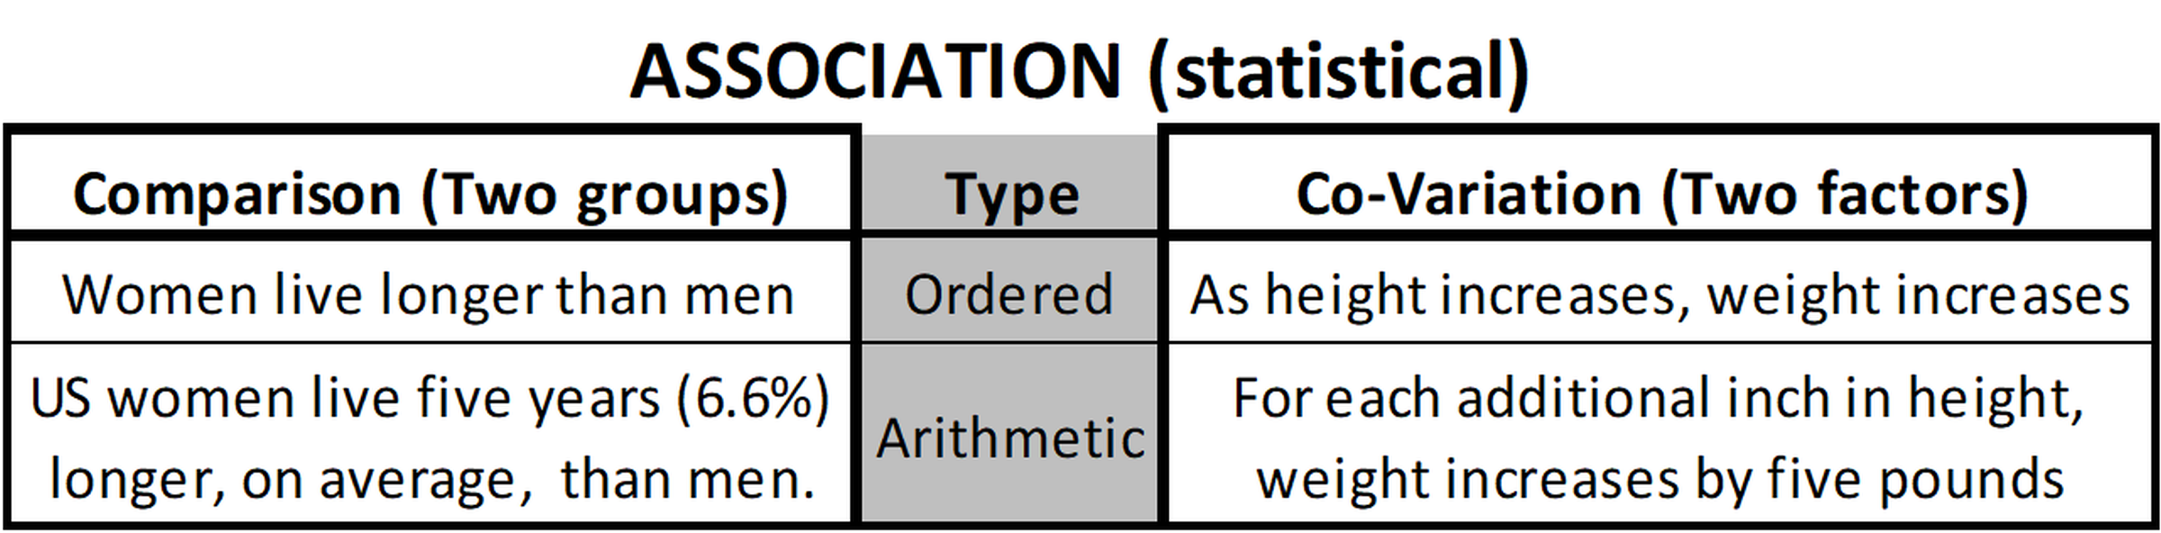
Association: Two Kinds
1
.
Covariation (correlation): science and math.
Two-group comparison: everyday media.
Notes:
StatLit for Managers
2013
2013Schield-MBAA
5
Analyzing Numbers in the News
15 May 2008
2008SchieldNNN6up.pdf
5
5

Slide 6
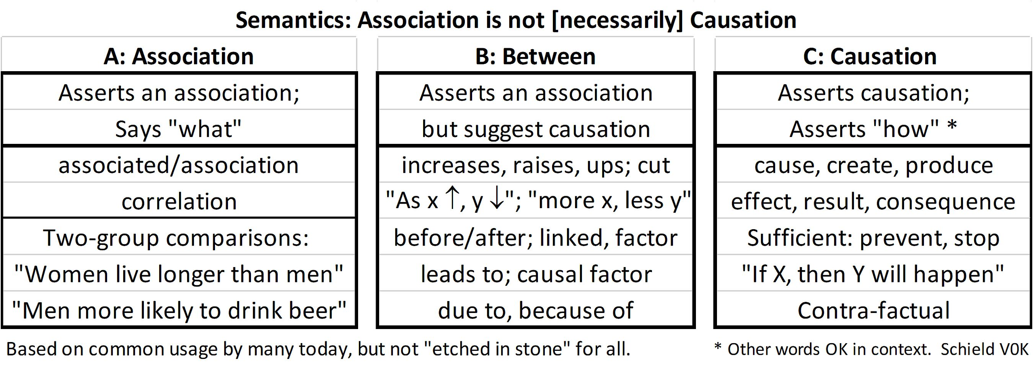
Association vs. Causation: Between Grammar
1
.
Notes:
StatLit for Managers
2013
2013Schield-MBAA
6
Analyzing Numbers in the News
15 May 2008
2008SchieldNNN6up.pdf
6
6

Slide 7
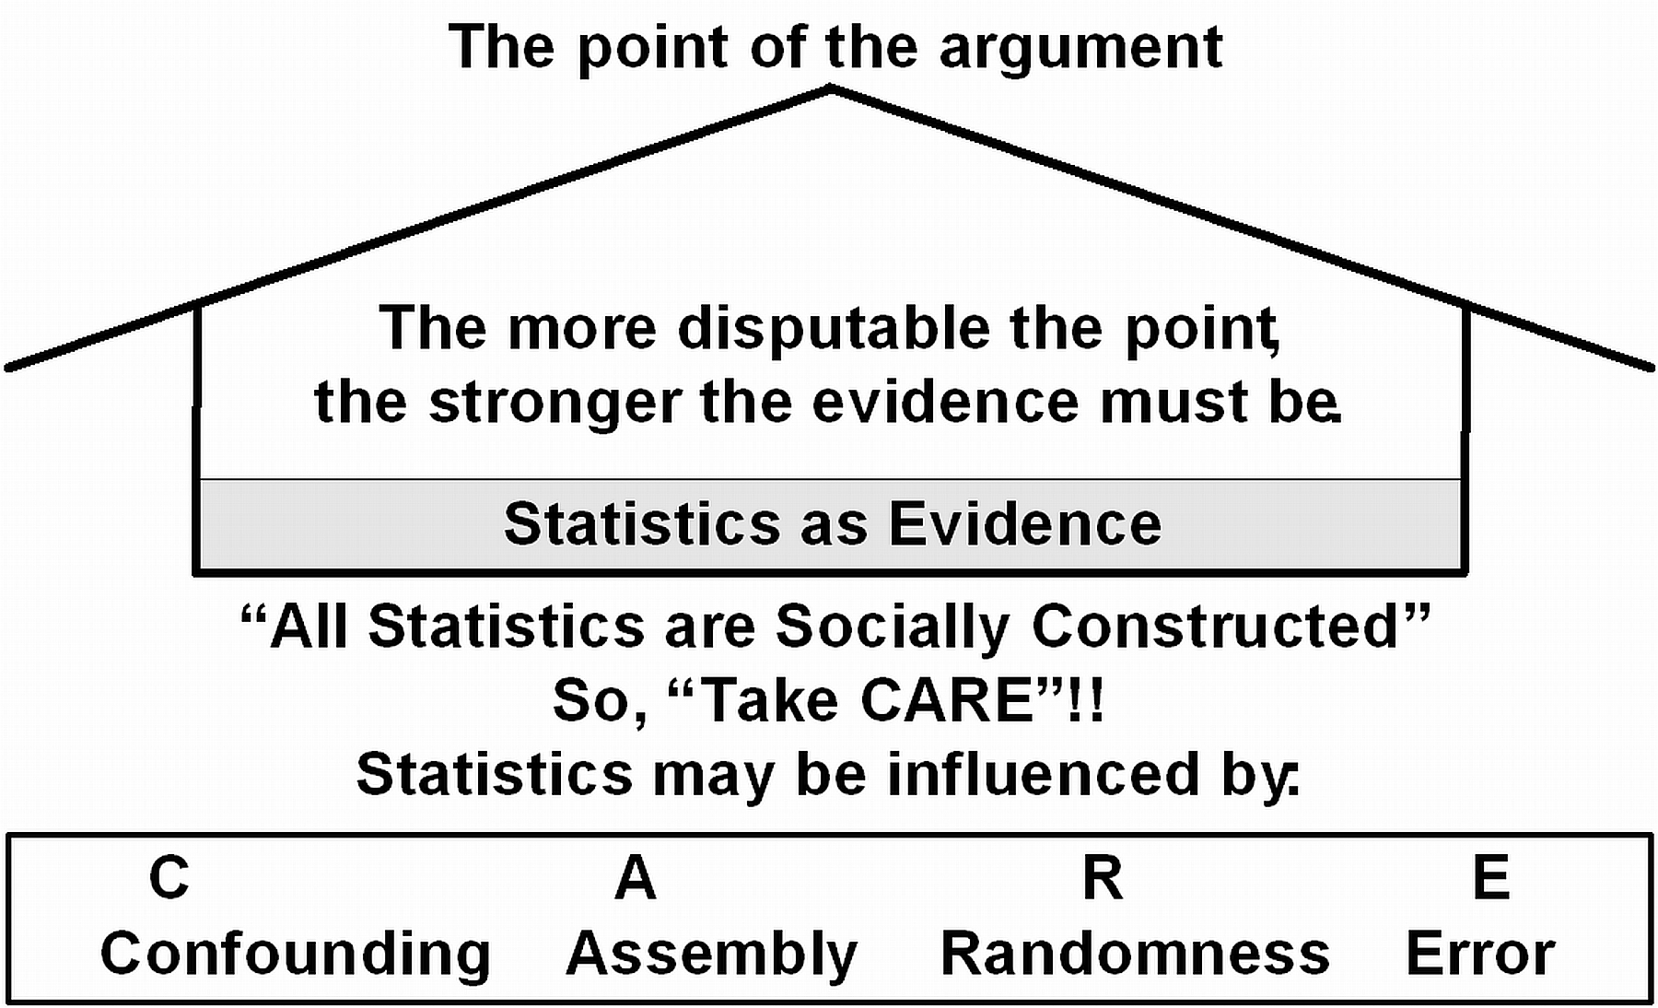
Statistics in Arguments; Statistics can be Influenced
1
.
Notes:
StatLit for Managers
2013
2013Schield-MBAA
7
Analyzing Numbers in the News
15 May 2008
2008SchieldNNN6up.pdf
7
7

Slide 8
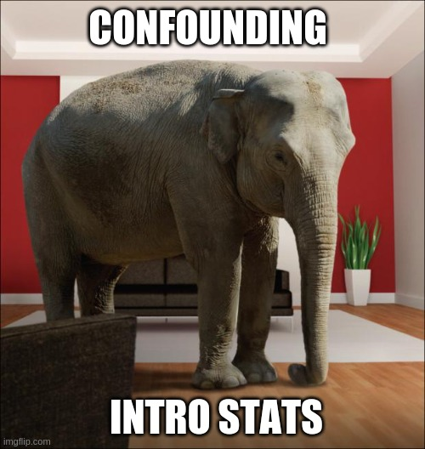
Confounding is the elephant in observational statistics
8
Teachers know it.
Not in intro. statistics or research methods.
It should be taught in an introductory course.
There isn’t time in traditional statistics.
Notes:
Analyzing Numbers in the News
15 May 2008
2008SchieldNNN6up.pdf
8
8

Slide 9
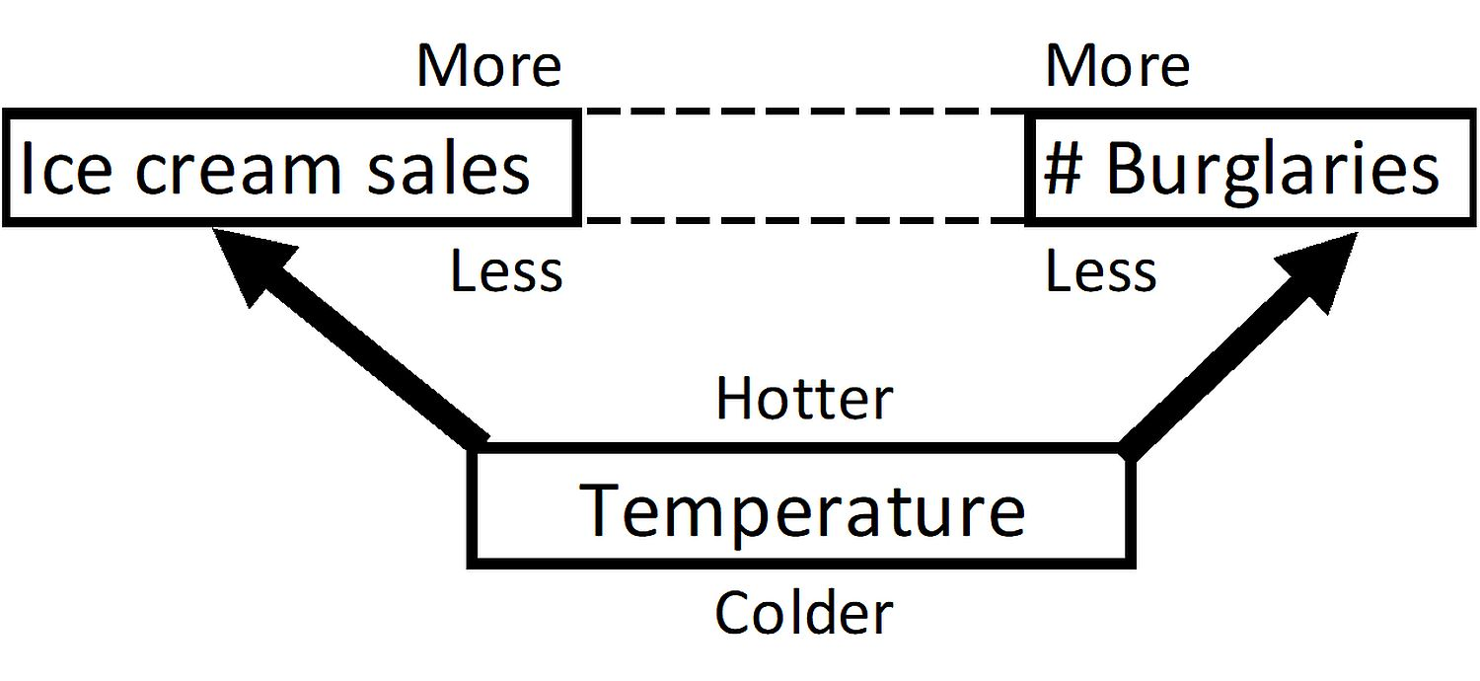
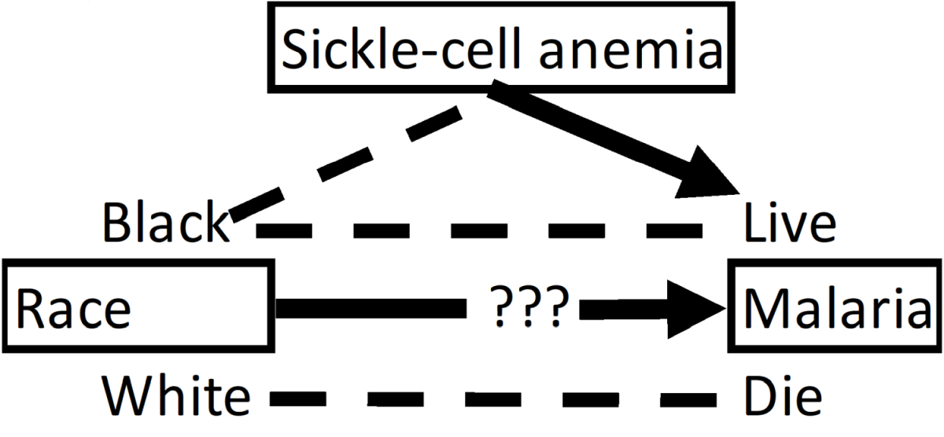
Confounding
1
MV
.
Confounding is “huge”!
Students in front row do better than in back row
Notes:
StatLit for Managers
2013
2013Schield-MBAA
9
Analyzing Numbers in the News
15 May 2008
2008SchieldNNN6up.pdf
9
9

Slide 10
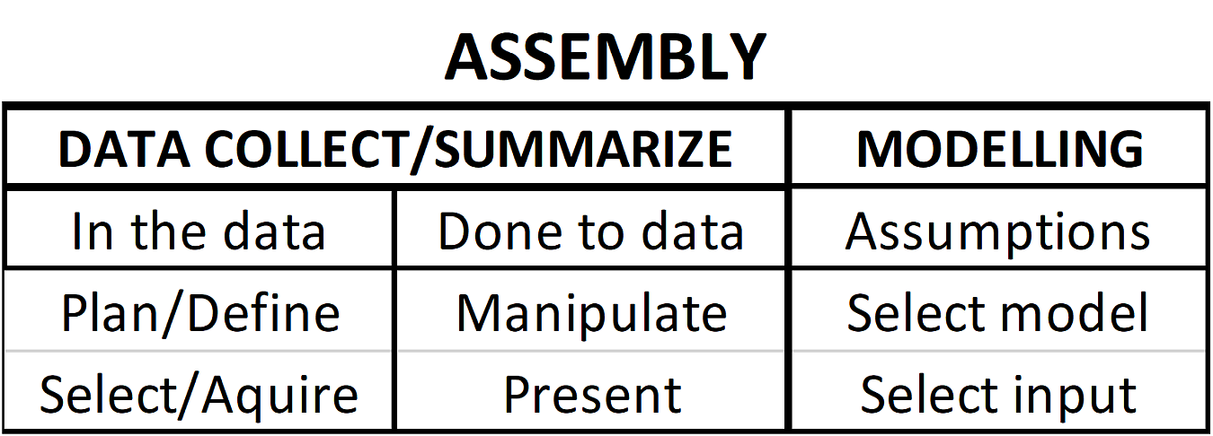
Assembly
1
.
Assembly is “huge”!
Define “bullying”, “unemployed”, “dropout”.
Notes:
StatLit for Managers
2013
2013Schield-MBAA
10
Analyzing Numbers in the News
15 May 2008
2008SchieldNNN6up.pdf
10
10

Slide 11
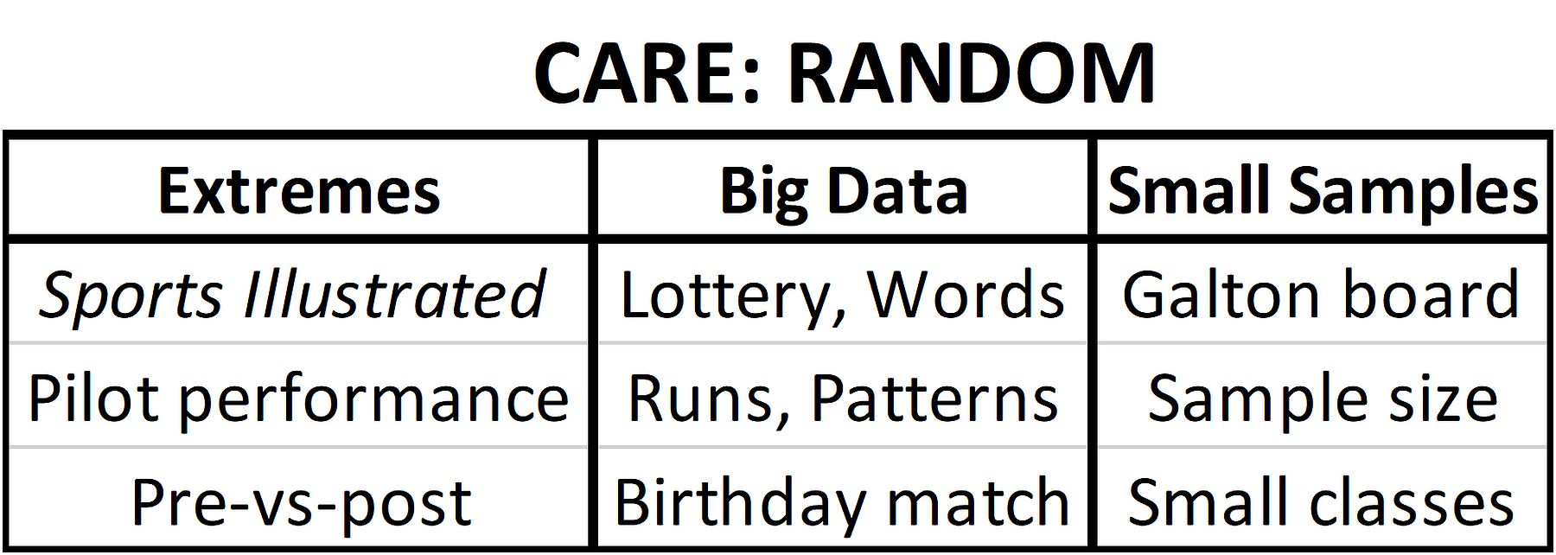
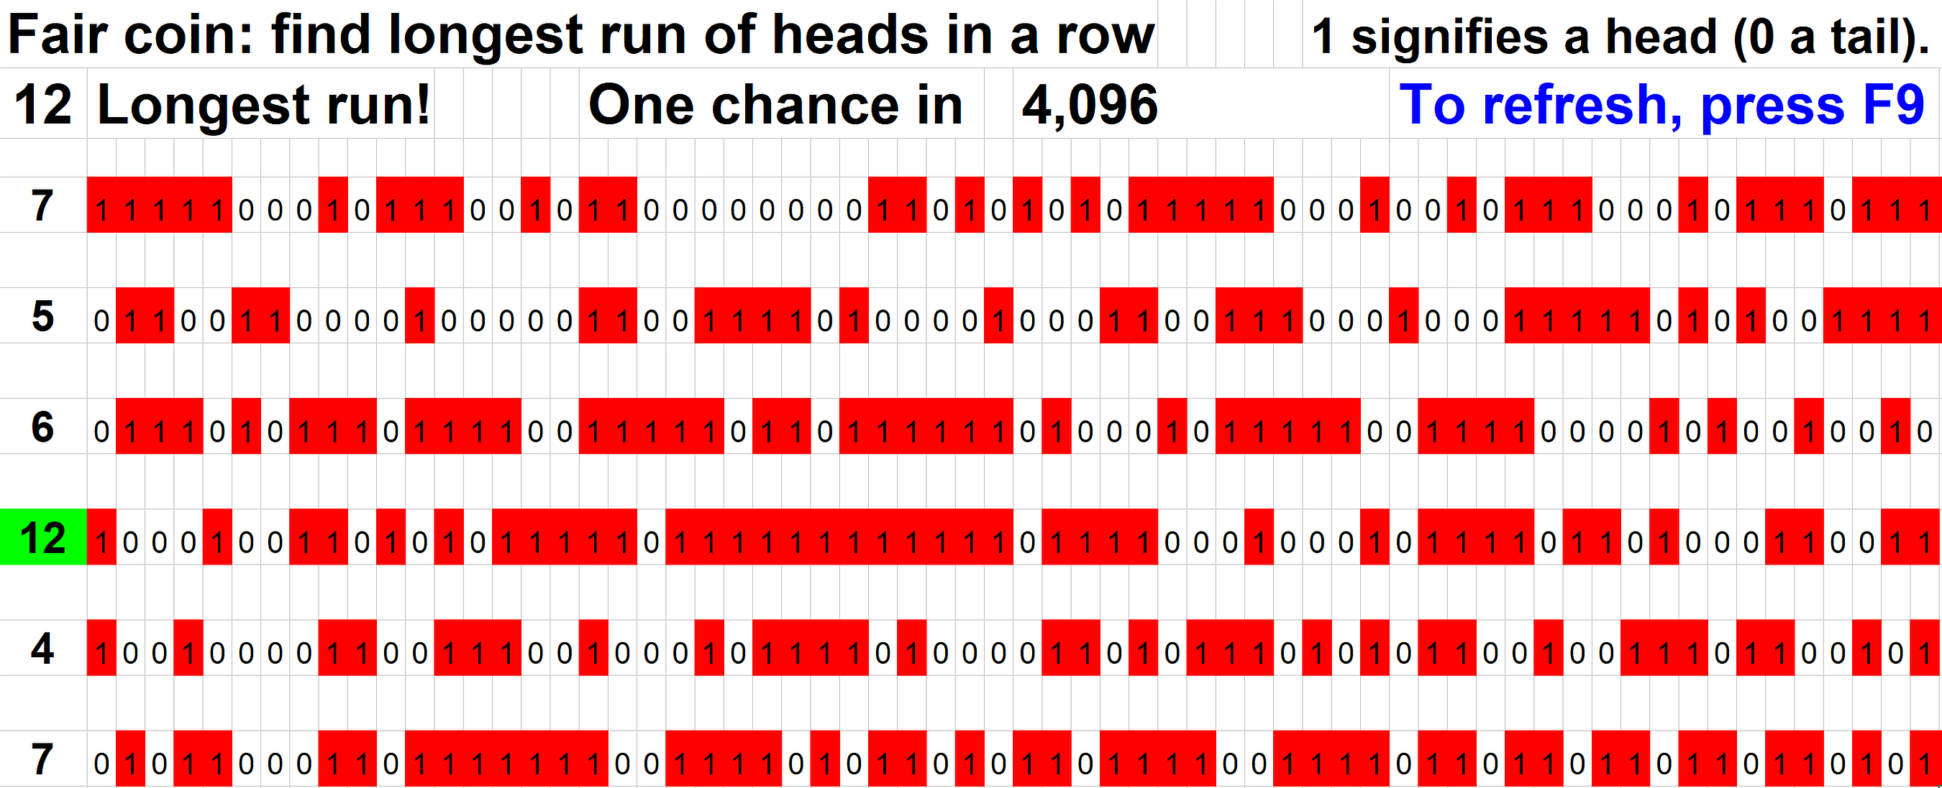
Randomness
1
.
Notes:
StatLit for Managers
2013
2013Schield-MBAA
11
Analyzing Numbers in the News
15 May 2008
2008SchieldNNN6up.pdf
11
11

Slide 12
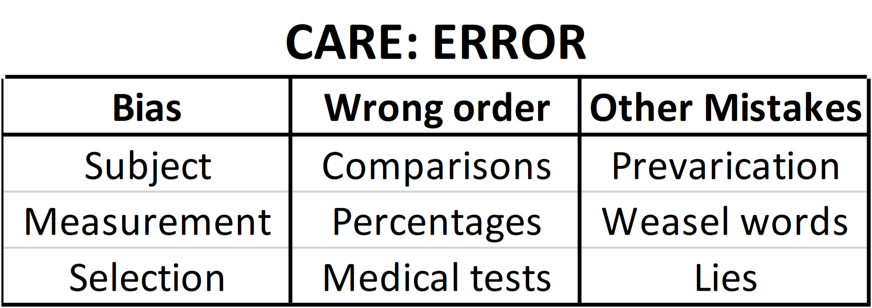
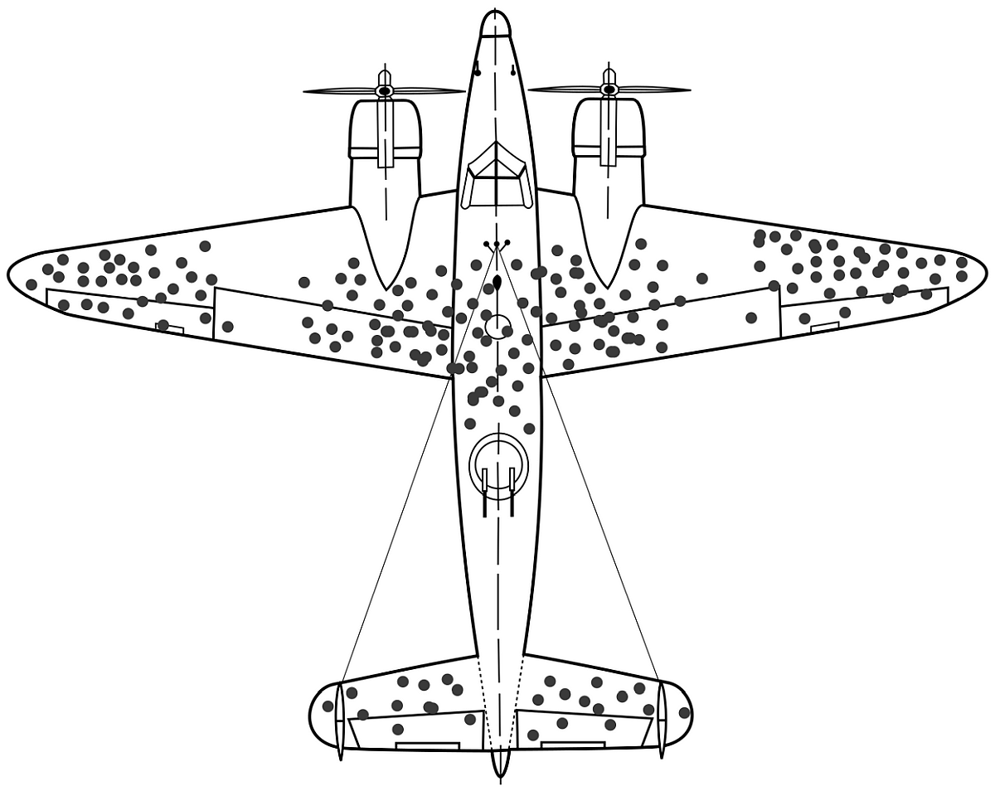
Error (bias)
1
.
Notes:
StatLit for Managers
2013
2013Schield-MBAA
12
Analyzing Numbers in the News
15 May 2008
2008SchieldNNN6up.pdf
12
12

Slide 13
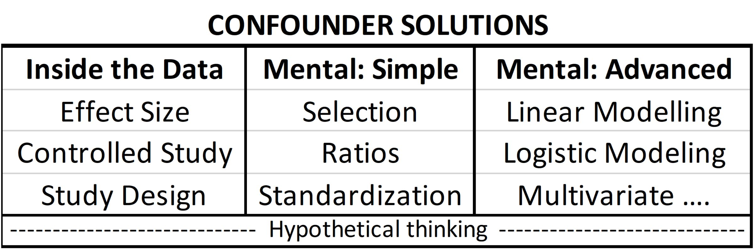
Confounder Solutions:
2
MV
Study Mental-Advanced in a statistics course.
Study Mental-Simple later in this course.
Study “study design” and “effect size” first.
Notes:
StatLit for Managers
2013
2013Schield-MBAA
13
Analyzing Numbers in the News
15 May 2008
2008SchieldNNN6up.pdf
13
13

Slide 14
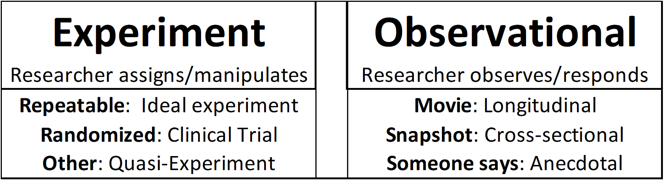
Confounder Solutions: Study Design
2
MV
“Studies say”
Hard science Soft science
Notes:
StatLit for Managers
2013
2013Schield-MBAA
14
Analyzing Numbers in the News
15 May 2008
2008SchieldNNN6up.pdf
14
14

Slide 15
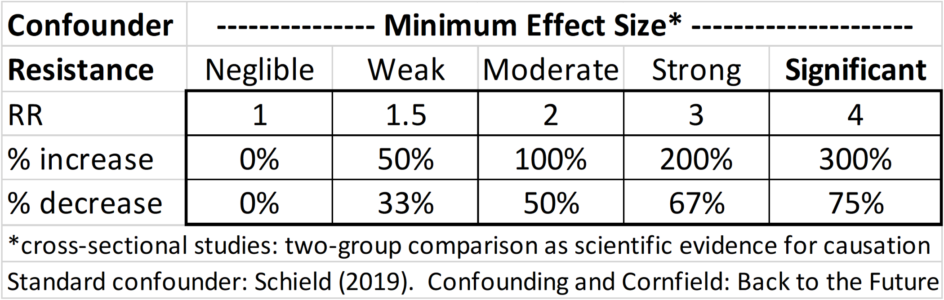
Confounder Solutions: Effect Size
2
MV
Quantitative news stories:
An estimated one-third do not include effect size.
Notes:
StatLit for Managers
2013
2013Schield-MBAA
15
Analyzing Numbers in the News
15 May 2008
2008SchieldNNN6up.pdf
15
15

Slide 16
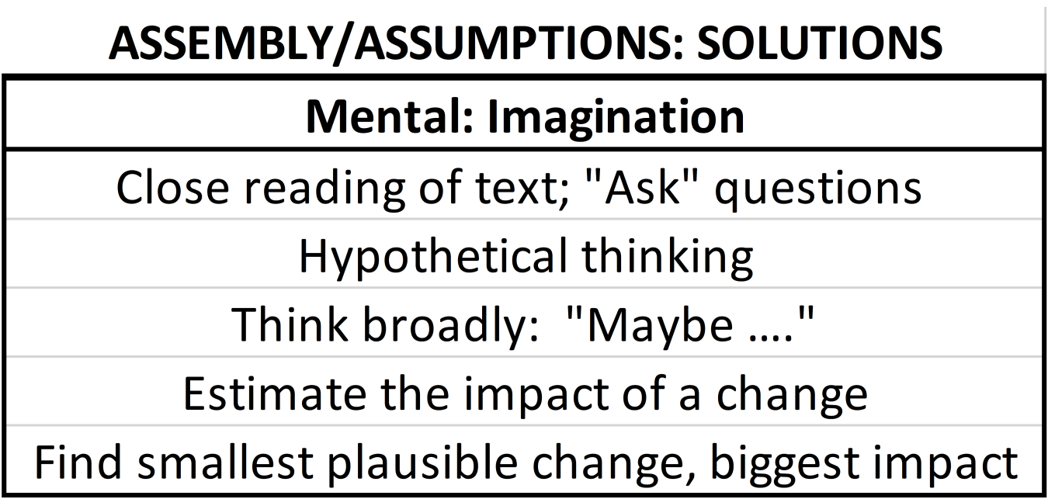
Assembly Solutions: “Think”
2
Hypothetical thinking in a math course
may be foreign to students and to teachers.
Notes:
StatLit for Managers
2013
2013Schield-MBAA
16
Analyzing Numbers in the News
15 May 2008
2008SchieldNNN6up.pdf
16
16

Slide 17
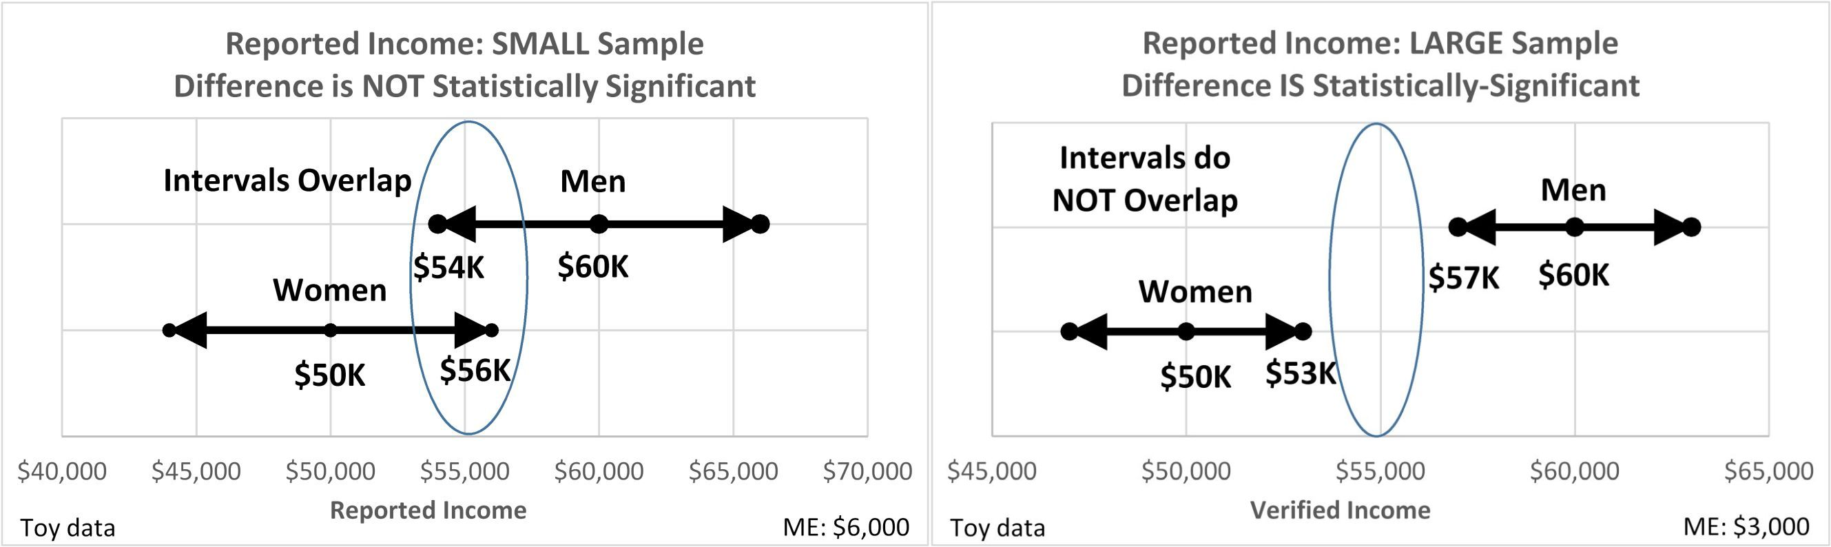
Randomness Solutions: Random Sampling Error
2
Given margin of error, create confidence intervals;
If confidence intervals don’t overlap, then difference in sample means is statistically significant.
Notes:
StatLit for Managers
2013
2013Schield-MBAA
17
Analyzing Numbers in the News
15 May 2008
2008SchieldNNN6up.pdf
17
17

Slide 18
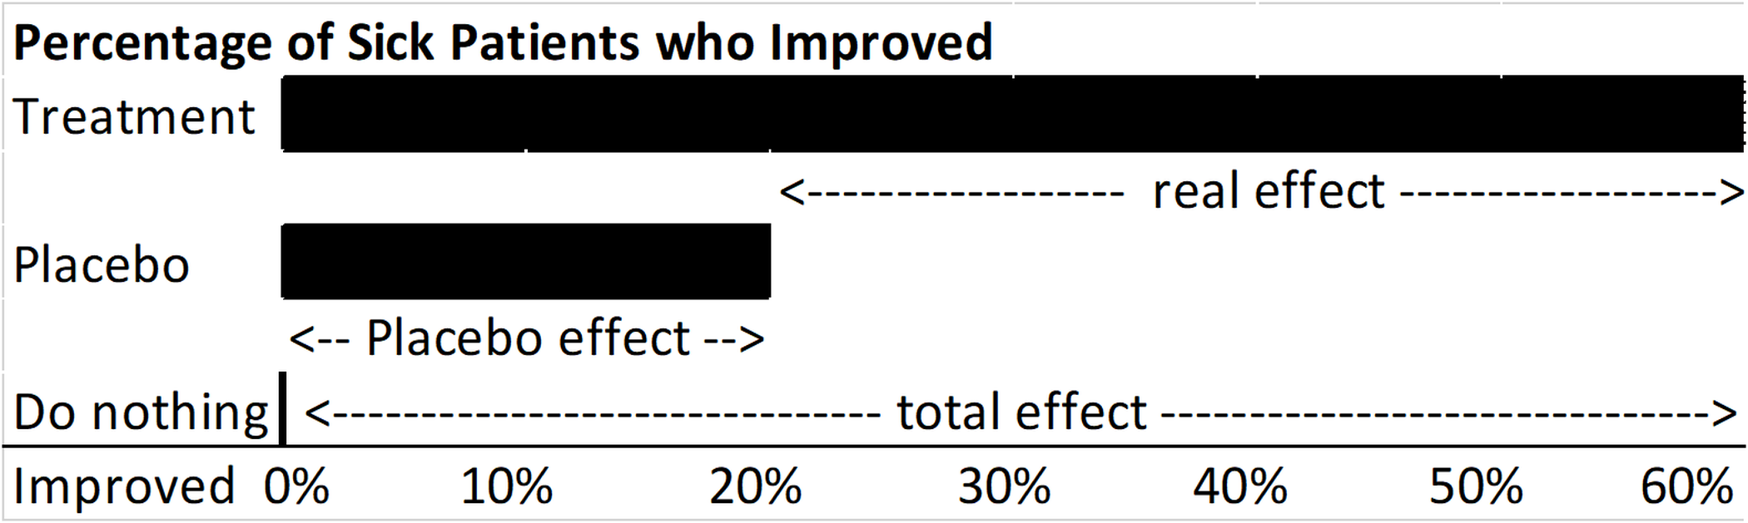
Error (Bias) Solutions: Placebo; single/double blind
2
Use placebo to determine the placebo effect.
Blinding students and teachers is
almost impossible in education.
Notes:
StatLit for Managers
2013
2013Schield-MBAA
18
Analyzing Numbers in the News
15 May 2008
2008SchieldNNN6up.pdf
18
18

Slide 19
Measures of Center: Alphabetical when skewed
3
Mean is most sensitive to extremes
Notes:
StatLit for Managers
2013
2013Schield-MBAA
19
Analyzing Numbers in the News
15 May 2008
2008SchieldNNN6up.pdf
19
19

Slide 20
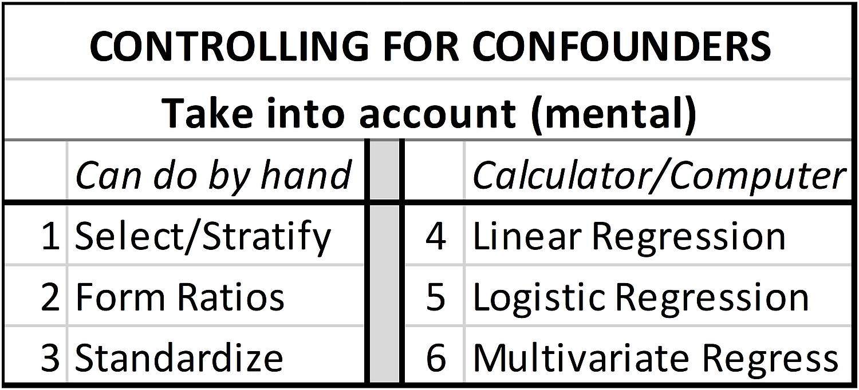
Confounding: Mental Solutions
3
MV
Statistical Literacy: How much can you “take into account” by hand?
Notes:
StatLit for Managers
2013
2013Schield-MBAA
20
Analyzing Numbers in the News
15 May 2008
2008SchieldNNN6up.pdf
20
20

Slide 21
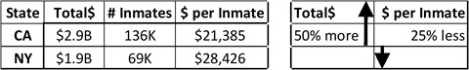
Comparison of Amounts: Control for Size
3
Prison Expenses by State:
Comparison reverses after controlling for size of group (per inmate).
Students already know this.
This is not multivariate
Notes:
StatLit for Managers
2013
2013Schield-MBAA
21
Analyzing Numbers in the News
15 May 2008
2008SchieldNNN6up.pdf
21
21

Slide 22
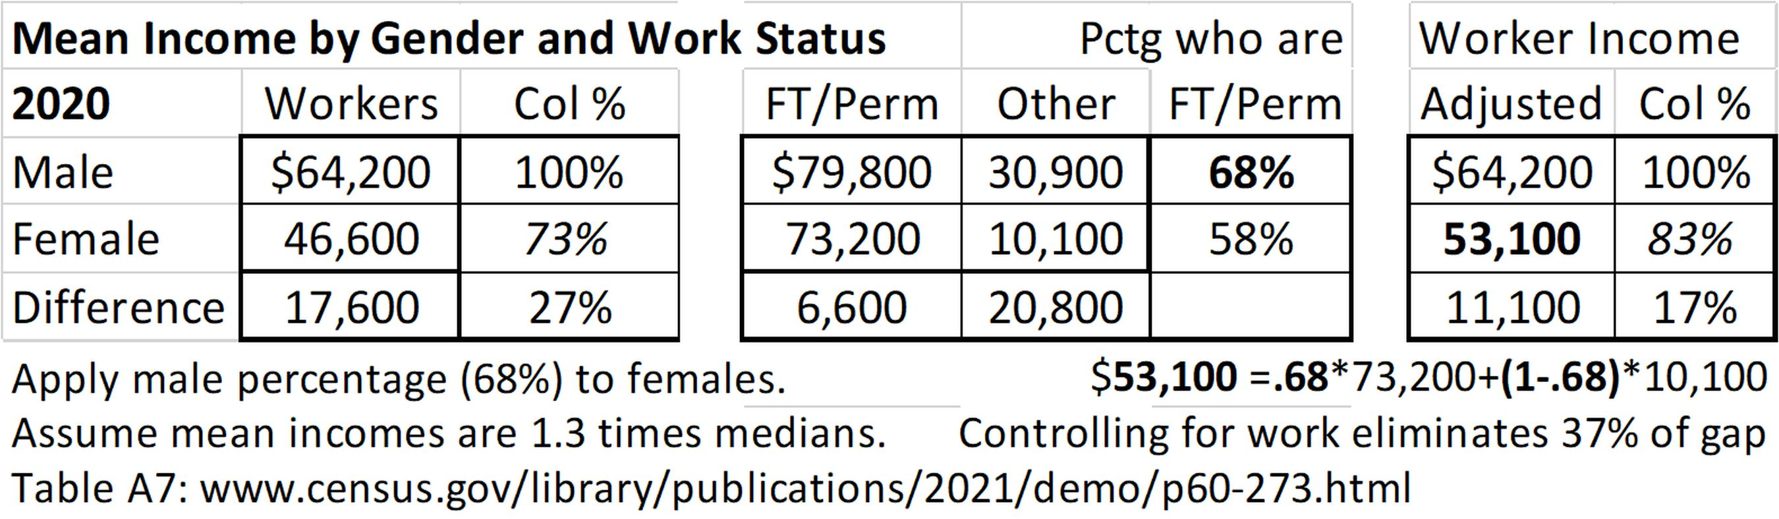
Taking into Account: Arithmetically
3
MV
Working women earn 73 cents for every dollar a man earns.
After taking into account work status, women earn 83 cents for every dollar a man makes
Notes:
StatLit for Managers
2013
2013Schield-MBAA
22
Analyzing Numbers in the News
15 May 2008
2008SchieldNNN6up.pdf
22
22

Slide 23
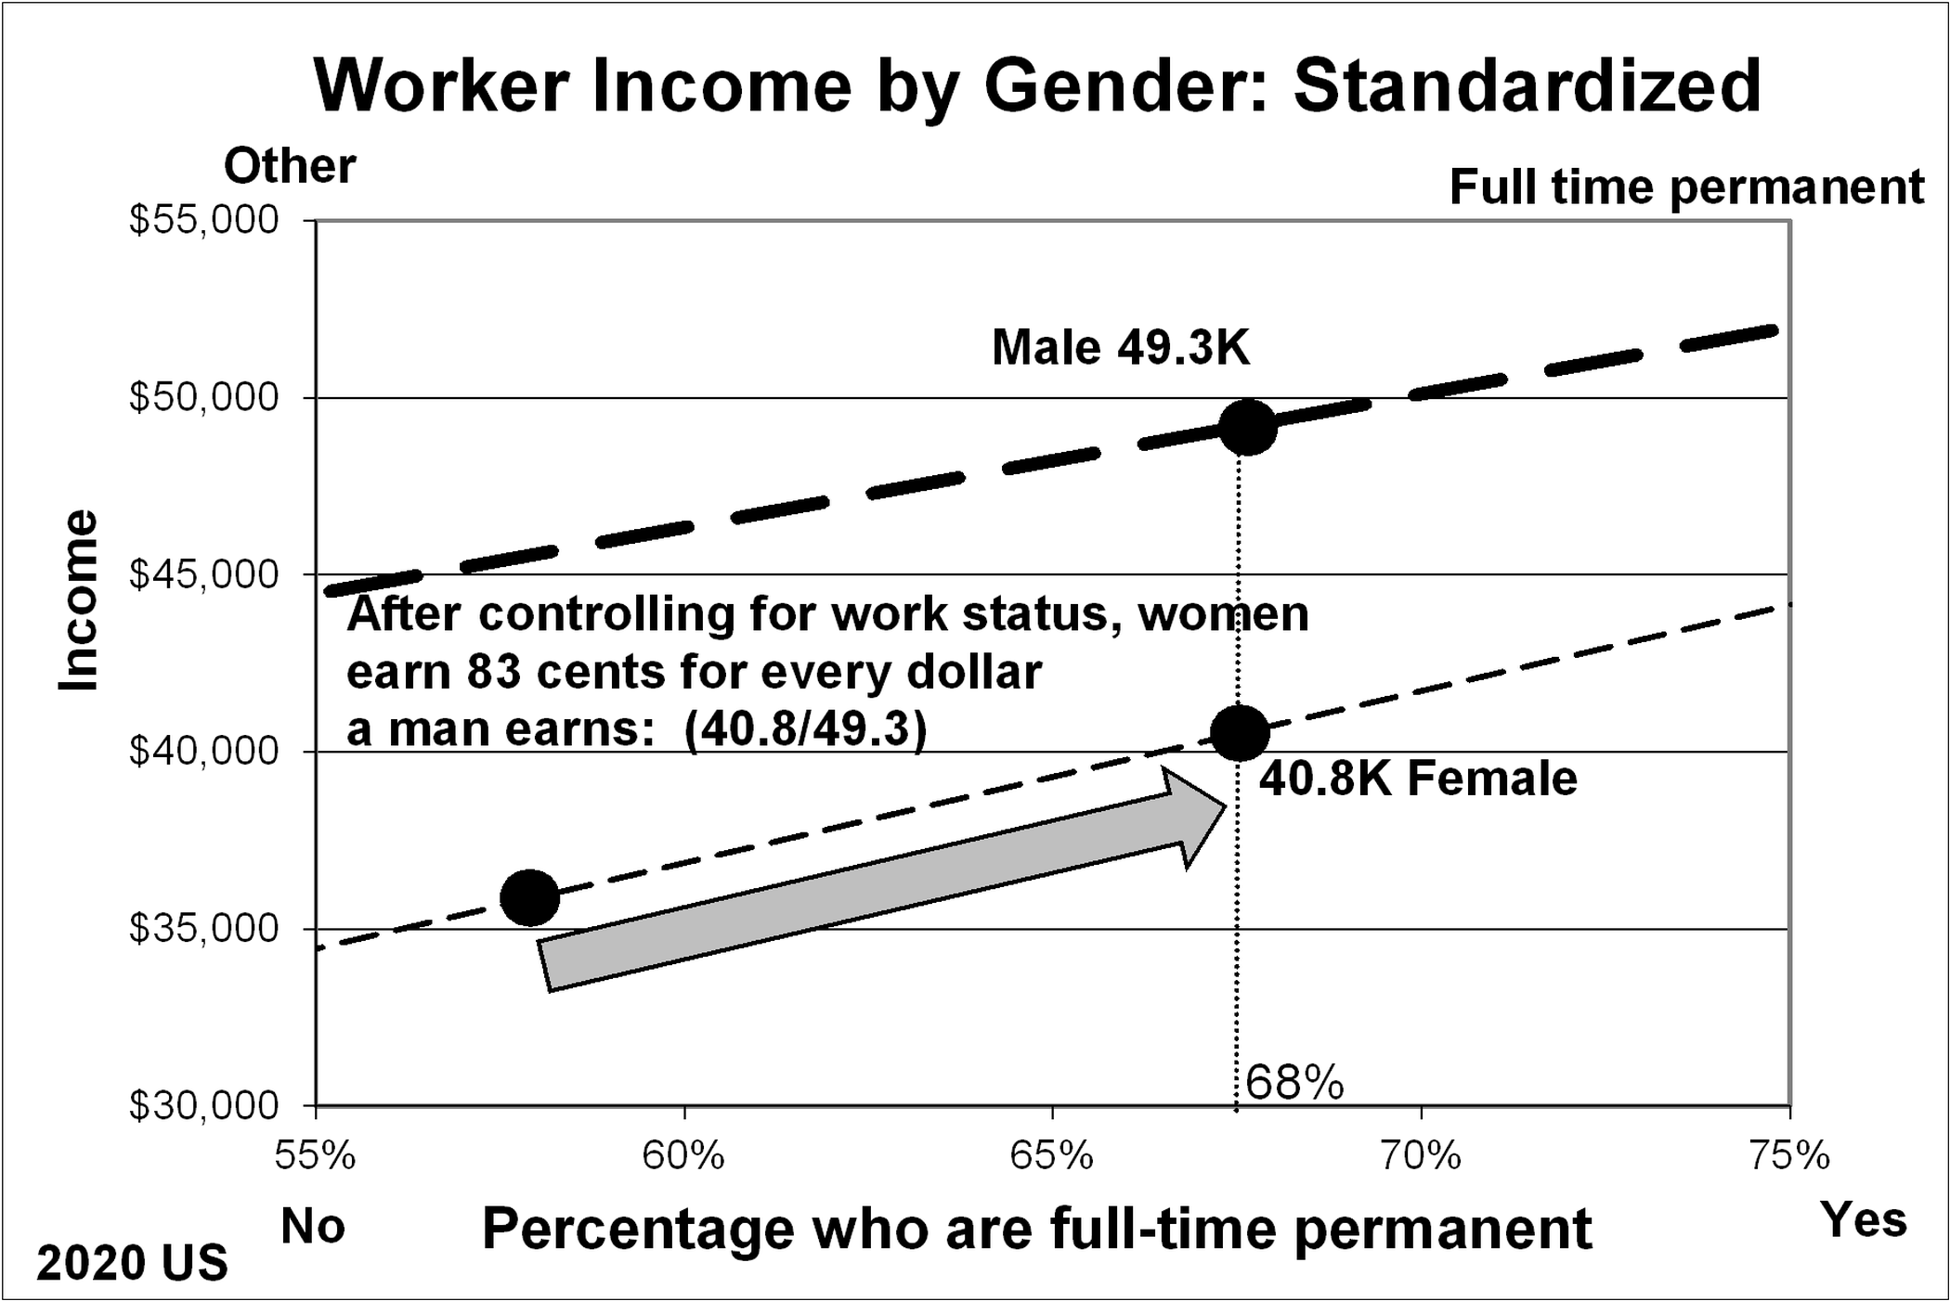
Taking into Account: Graphically
3
MV
.
Notes:
StatLit for Managers
2013
2013Schield-MBAA
23
Analyzing Numbers in the News
15 May 2008
2008SchieldNNN6up.pdf
23
23

Slide 24
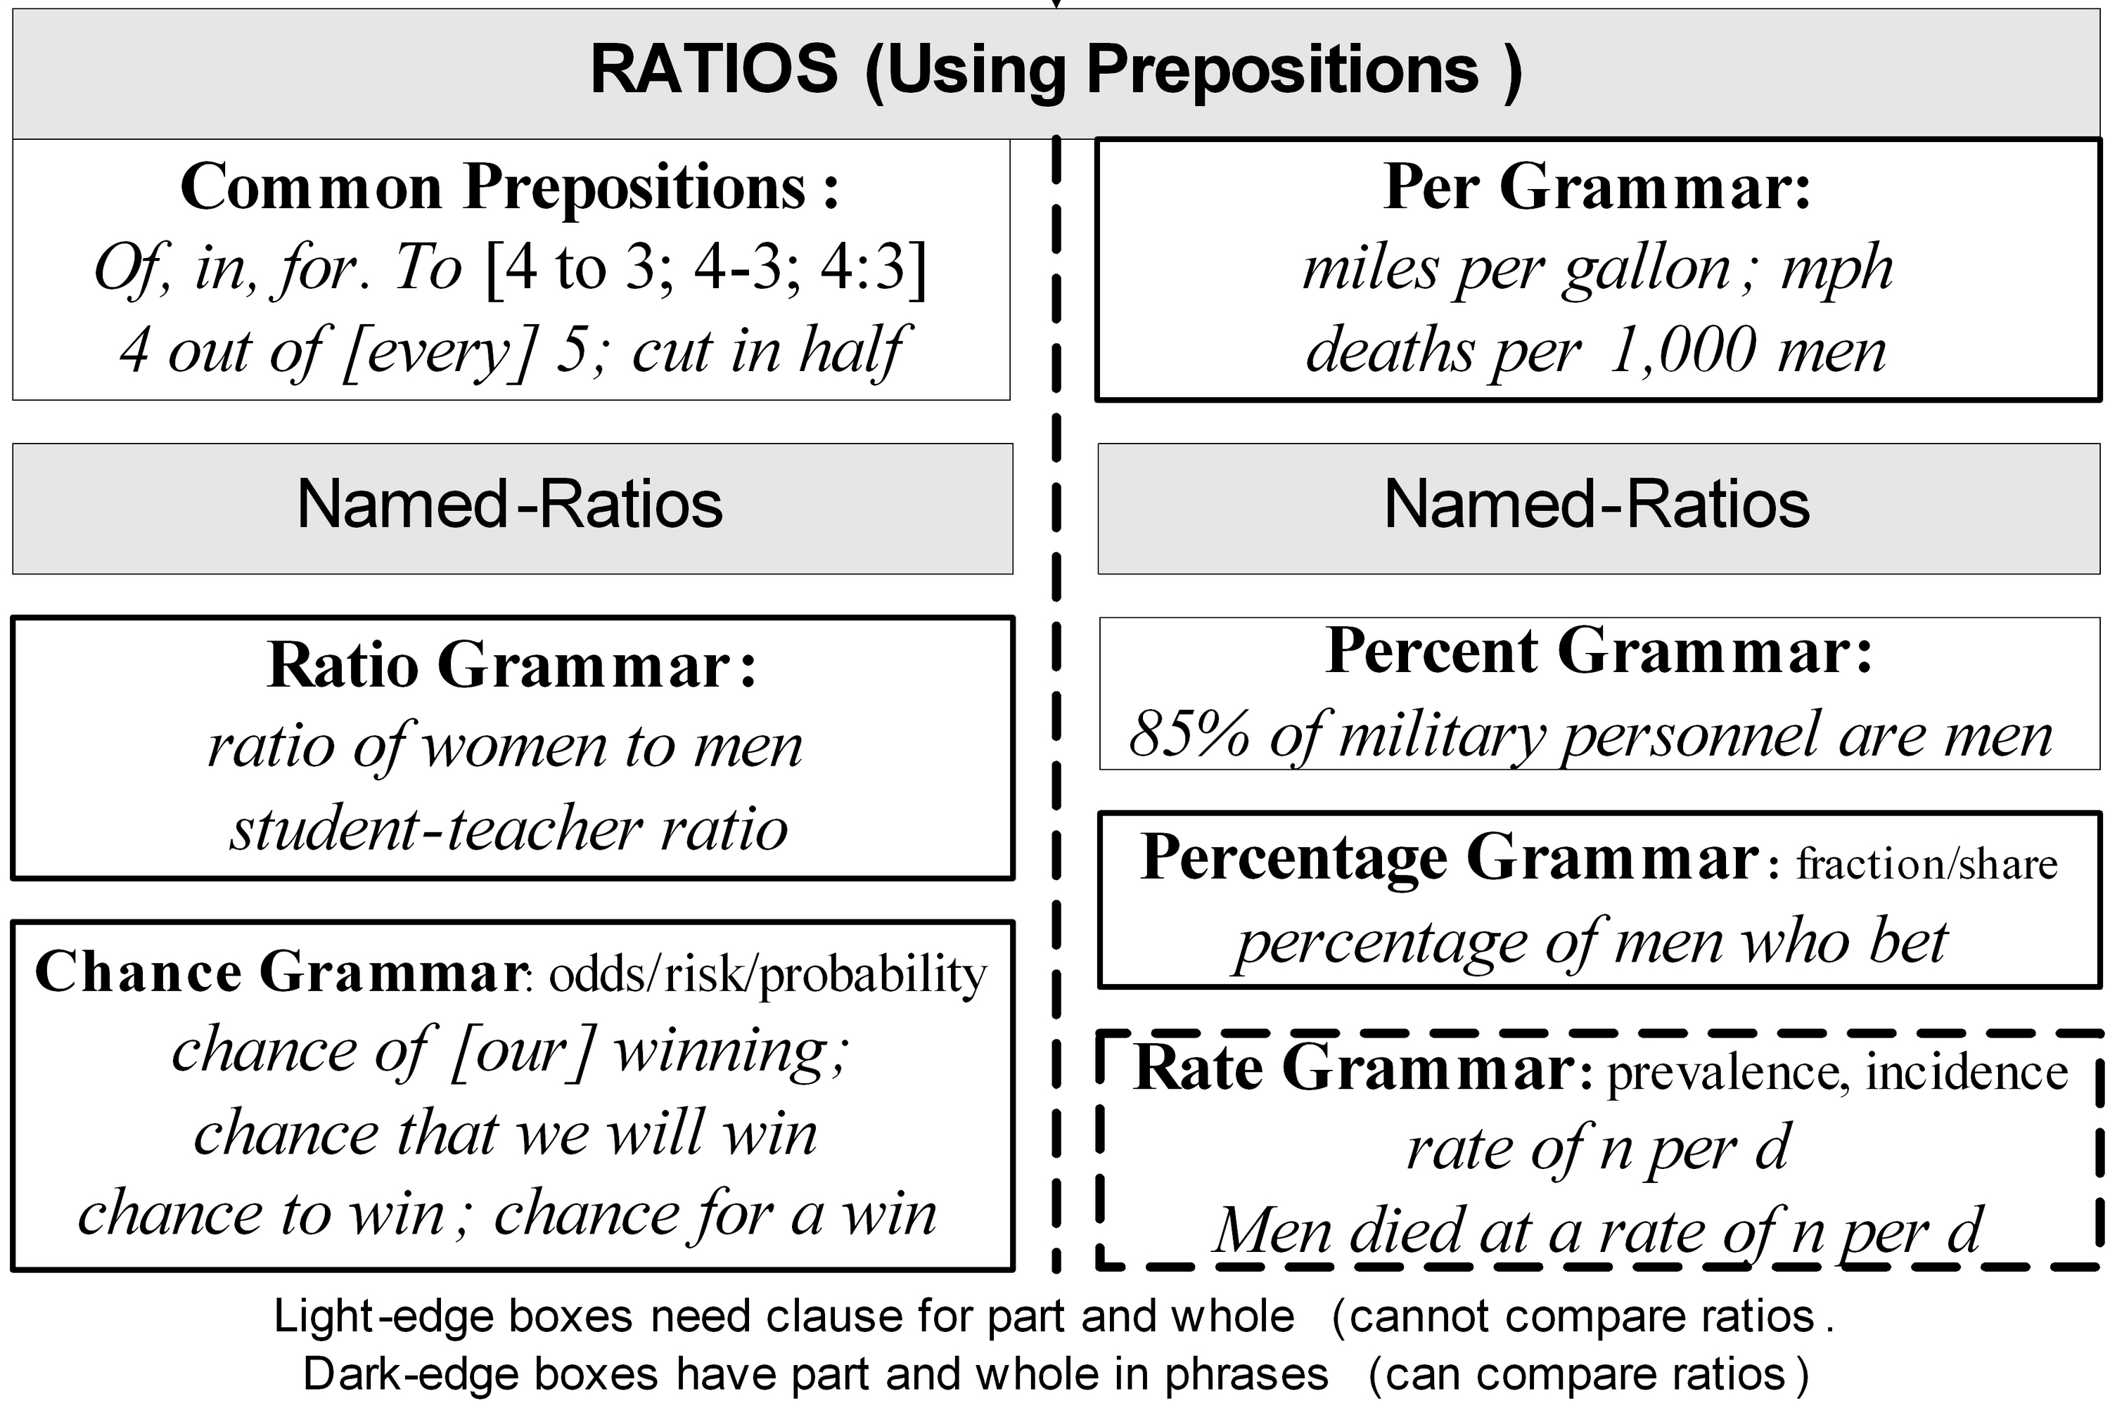
Taking into Account: Graphically
.
Notes:
StatLit for Managers
2013
2013Schield-MBAA
24
Analyzing Numbers in the News
15 May 2008
2008SchieldNNN6up.pdf
24
24

Slide 25
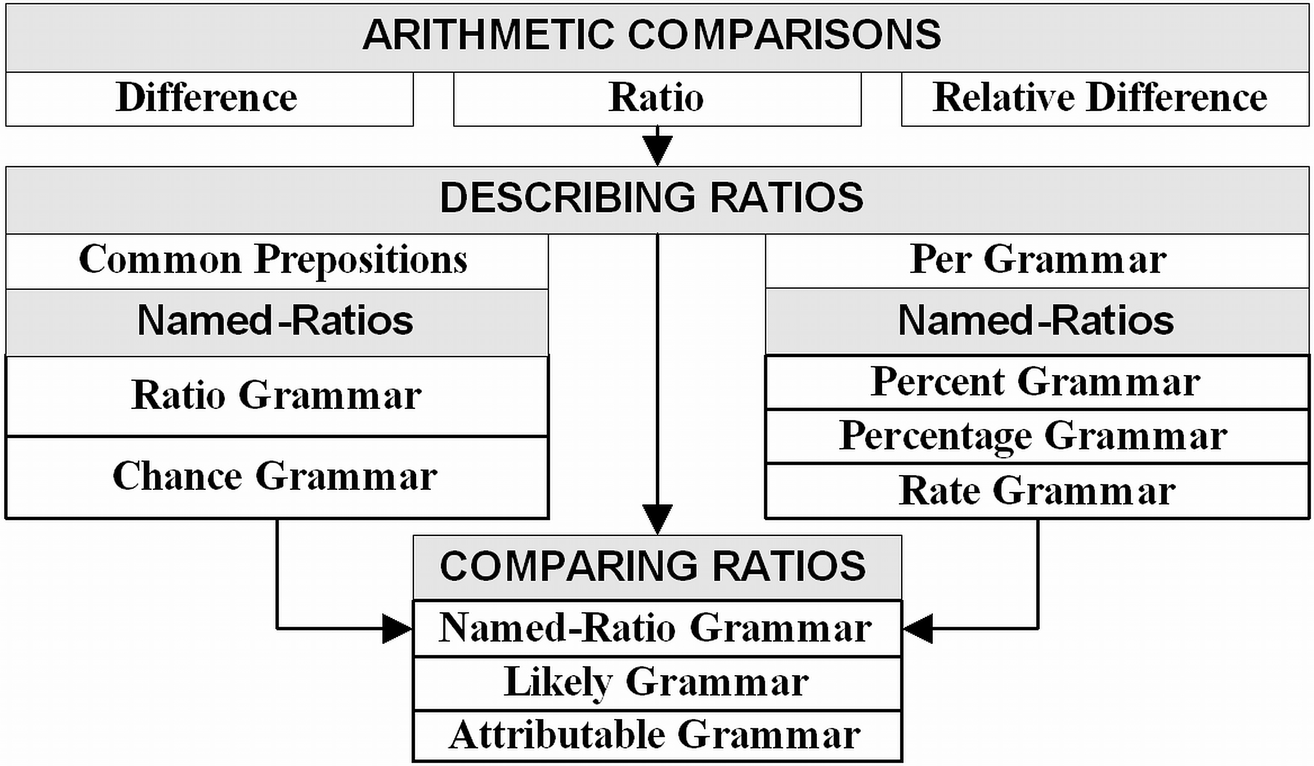
From Ratios to Comparing Ratios
6
.
Notes:
StatLit for Managers
2013
2013Schield-MBAA
25
Analyzing Numbers in the News
15 May 2008
2008SchieldNNN6up.pdf
25
25

Slide 26
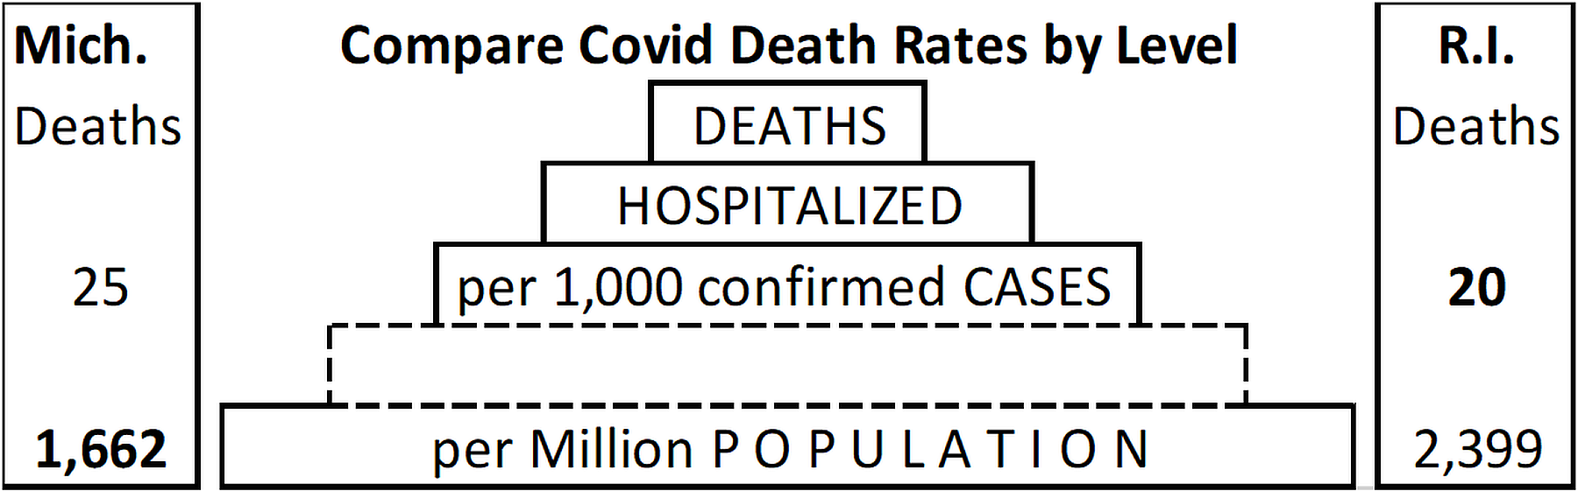
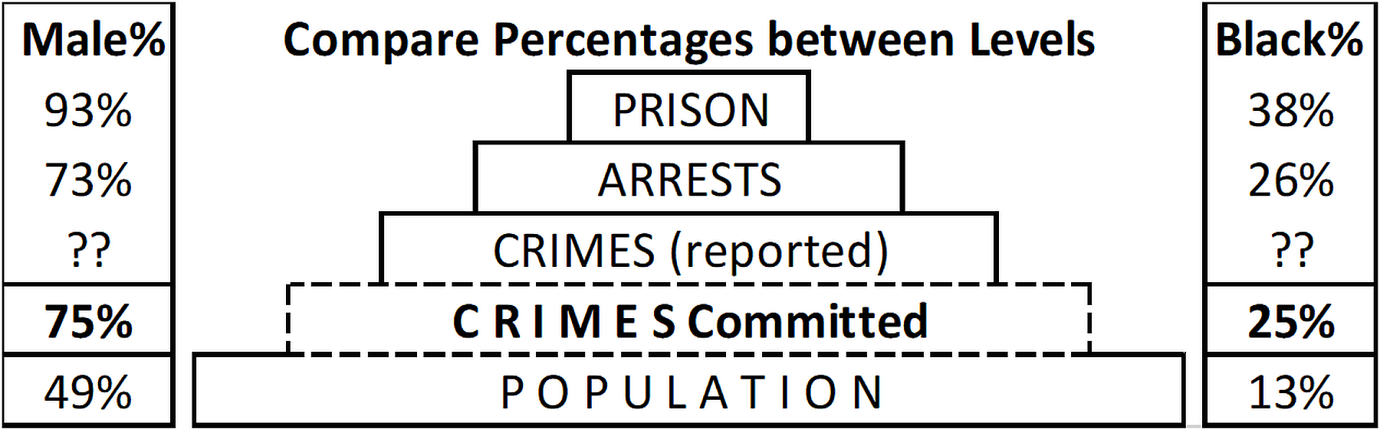
Diabolical Denominators
7
.
Notes:
StatLit for Managers
2013
2013Schield-MBAA
26
Analyzing Numbers in the News
15 May 2008
2008SchieldNNN6up.pdf
26
26

Slide 27
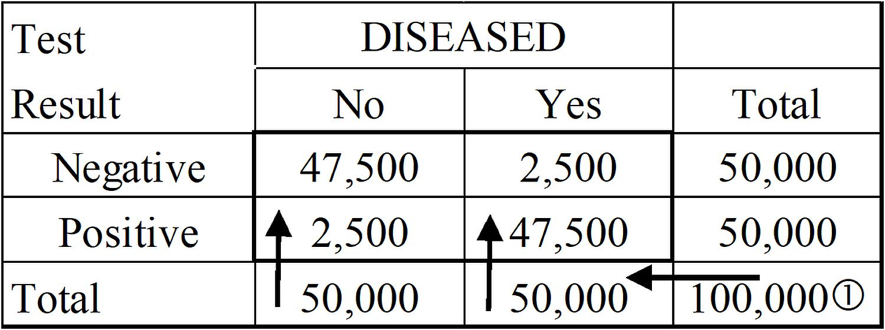
Medical Tests “Accuracy” is equivocal
7
If disease prevalence is 50%,
then predictive accuracy equals confirmation accuracy.
Notes:
StatLit for Managers
2013
2013Schield-MBAA
27
Analyzing Numbers in the News
15 May 2008
2008SchieldNNN6up.pdf
27
27

Slide 28
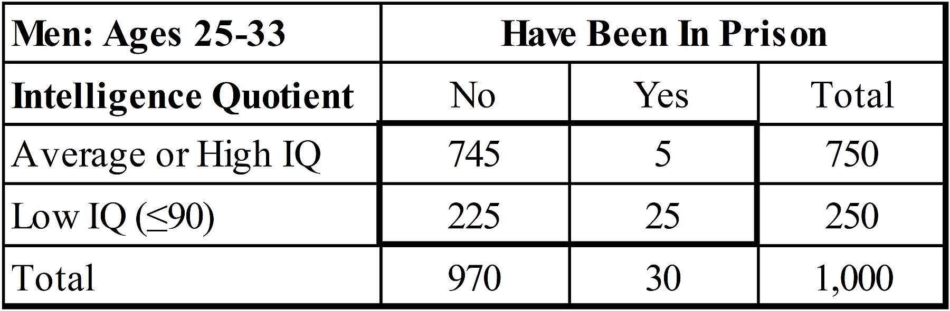
Social Statistics: Explain vs. Predict
7
Low IQ explains prison (83%).
Low IQ is a poor predictor of prison (10%).
Notes:
StatLit for Managers
2013
2013Schield-MBAA
28
Analyzing Numbers in the News
15 May 2008
2008SchieldNNN6up.pdf
28
28

Slide 29
Cornfield Condition #1 To nullify/reverse association,
7
MV
Confounder-outcome must exceed predictor-outcome.
Notes:
StatLit for Managers
2013
2013Schield-MBAA
29
Analyzing Numbers in the News
15 May 2008
2008SchieldNNN6up.pdf
29
29

Slide 30
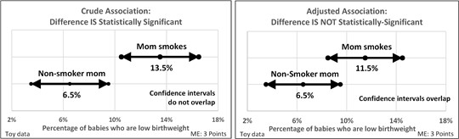
Statistical Significance: Influenced by Confounding
8
MV
Controlling for the age of the mom can change a statistically-significant difference into one that is NOT statistically significant.
Notes:
StatLit for Managers
2013
2013Schield-MBAA
30
Analyzing Numbers in the News
15 May 2008
2008SchieldNNN6up.pdf
30
30

Slide 31
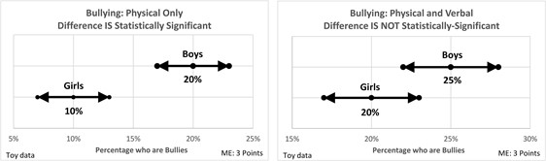
Statistical Significance: Influenced by Assembly
8
A small change in the definition can change a statistically-significant difference into one that is NOT statistically significant.
Notes:
StatLit for Managers
2013
2013Schield-MBAA
31
Analyzing Numbers in the News
15 May 2008
2008SchieldNNN6up.pdf
31
31

Slide 32
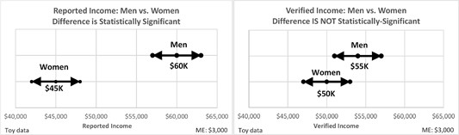
Statistical Significance: Influenced by Error/Bias
8
Male-female respondent bias can change a statistically-significant difference into one that is NOT statistically significant.
Notes:
StatLit for Managers
2013
2013Schield-MBAA
32
Analyzing Numbers in the News
15 May 2008
2008SchieldNNN6up.pdf
32
32

Slide 33
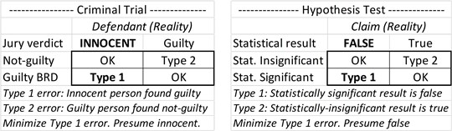
Hypothesis Test Like a Criminal Trial
8
Innocent until proven guilty is the same as
statistically-insignificant until proven otherwise.
Notes:
StatLit for Managers
2013
2013Schield-MBAA
33
Analyzing Numbers in the News
15 May 2008
2008SchieldNNN6up.pdf
33
33

Slide 34
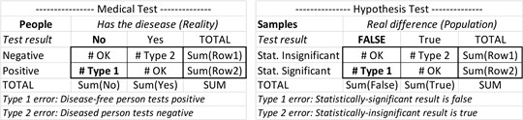
Hypothesis Test Like a Medical Test
8
If Research hypothesis is more likely than not to be true,
then a statistically-significant result means
we are 95% confident the research hypothesis is true.
Notes:
StatLit for Managers
2013
2013Schield-MBAA
34
Analyzing Numbers in the News
15 May 2008
2008SchieldNNN6up.pdf
34
34

Slide 35
Statistical Literacy: Student Views 1
Most important
“Take CARE” (50%)
Statistics are different from numbers (12%)
Statistical significance can be influenced (8%)
Confounding can influence an association (6%)
Most difficult:
Part-whole distinction
Standardizing (multivariate)
Named ratios (grammar)
54 students Spring semester 2023
Notes:
StatLit for Managers
2013
2013Schield-MBAA
35
Analyzing Numbers in the News
15 May 2008
2008SchieldNNN6up.pdf
35
35

Slide 36
Statistical Literacy: Student Views 2
How valuable in helping you read the news?
74%: High value 37%, Fair value 37%
26%: Some value 15%, neutral 9% or negative 2%
How helpful in developing critical thinking skills?
65%: Extremely 17%; Very 48%
35%: Somewhat 31%, Neutral 2%, Negative 2%.
54 students Spring semester 2023
Notes:
StatLit for Managers
2013
2013Schield-MBAA
36
Analyzing Numbers in the News
15 May 2008
2008SchieldNNN6up.pdf
36
36

Slide 37
Bibliography
Schield, M (2021). Statistical Literacy: Teaching Confounding. USCOTS. www.statlit.org/pdf/2021-Schield-USCOTS.pdf
Schield, M. (2022a). Statistical Literacy: Critical Thinking about Confounding. Conference on Critical Thinking. www.statlit.org/pdf/2022-Schield-CCT.pdf
Schield, M. (2022b). Statistical Literacy UNM Math 1300: First Year Results. Proceedings of the Section on Statistical and Data Science Education. P. 1235-1265. Copy at www.statlit.org/pdf/2022-Schield-ASA.pdf
Schield, M. (2023). Statistical Literacy: Critical Thinking about Everyday Statistics. Kendall-Hunt Publishing.
Notes:
StatLit for Managers
2013
2013Schield-MBAA
37
Analyzing Numbers in the News
15 May 2008
2008SchieldNNN6up.pdf
37
37

